Slide 1
Vector Space Concept

Slide 2
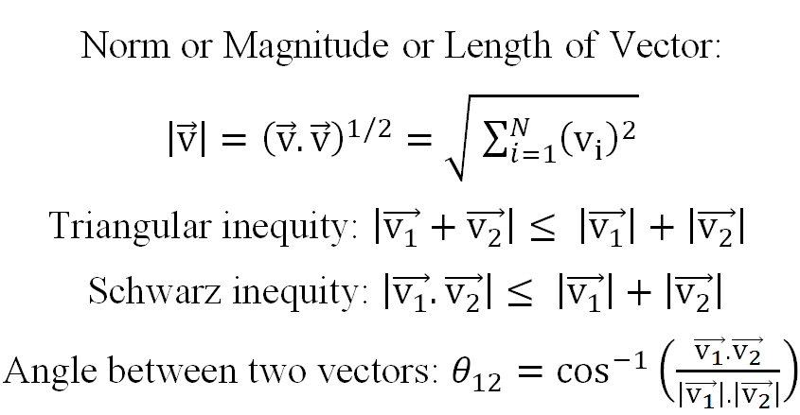

Slide 3
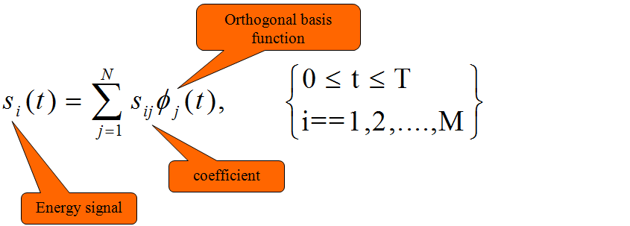
Signal Space Concept
Any set of M energy signals {s_{i}(t)} as linear combinations of
N orthogonal basis functions, where N ≤ M
Real value energy signals :
s₁(t), s₂(t),..s_{M}(t), each of duration T sec

Slide 4
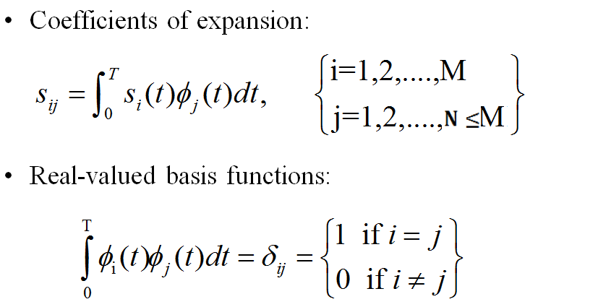

Slide 5
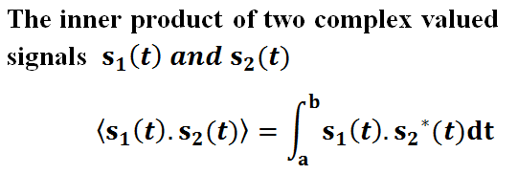
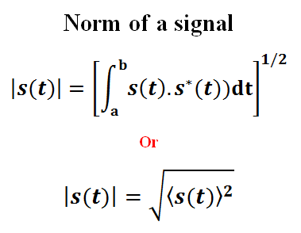

Slide 6
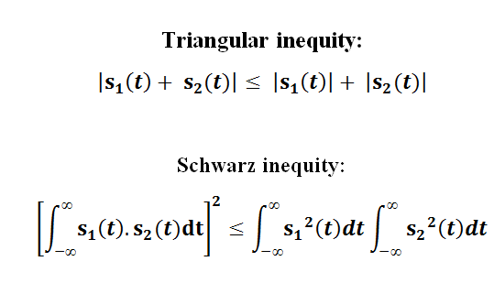
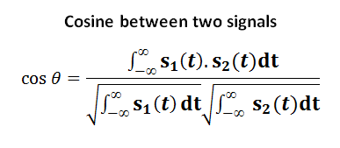

Slide 7
The set of coefficients s_{i} can be viewed as a
N-dimensional vector.
Bears a one-to-one relationship with the transmitted signal s_{i}(t)

Slide 8
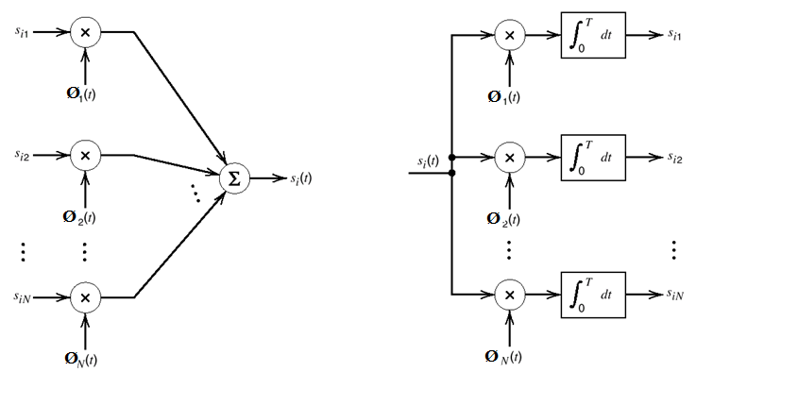
Synthesizer for generating the signal s_{i}(t) Analyzer for generating the set of signal vectors {s_{i}}

Slide 9
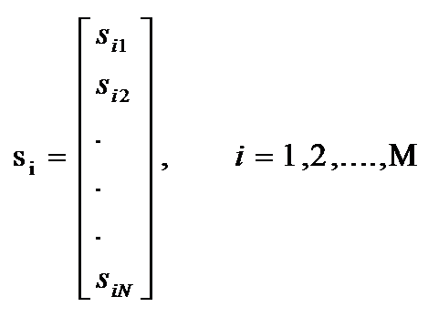
Each signal in the set s_{i}(t) is completely determined by the vector of its coefficients

Slide 10
The signal vector s_{i} can be extended to 2D, 3D etc. N-dimensional Euclidian space
Provides mathematical basis for the geometric representation of energy signals that is used in noise analysis
Allows definition of
Length of vectors (absolute value)
Angles between vectors
Squared value (inner product of s_{i} with itself)

Slide 11
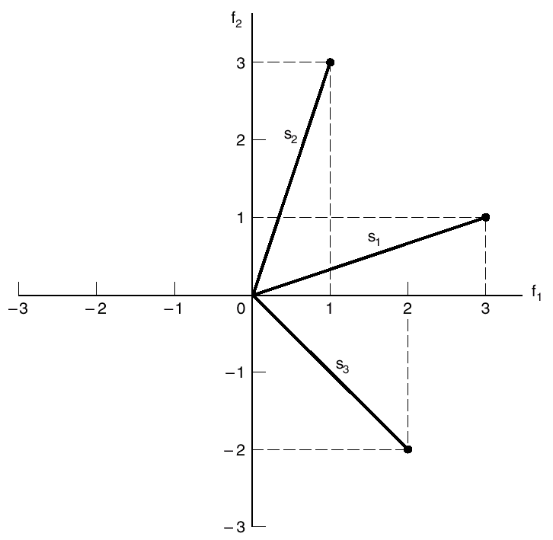
geometric representation of signals for the case when
N = 2 and M = 3. (two dimensional space, three signals)

Slide 12
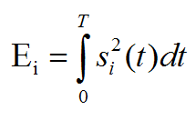
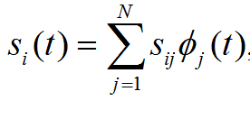
average energy in a signal:

Slide 13
Gram-Schmidt Orthogonalization Procedure
first basis function starting with s_{1 :}
or
using s₂ define the coefficient s₂₁ :
we introduce the intermediate function g₂ as:

Slide 14
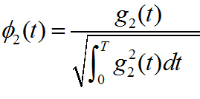
the second basis function φ₂(t) as:
In general :
the coefficients :
Given a function gi(t) we can define a set of basis functions, which form an orthogonal set, as:
For the special case of i = 1; g_{i}(t) = s_{i}(t)

Slide 15
NUMERICLAS …

Slide 16
Maximum likelihood decoding

Slide 17
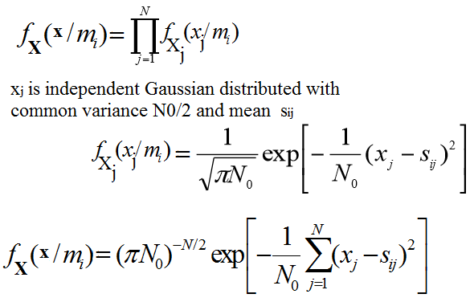

Slide 18
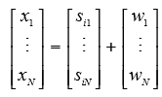
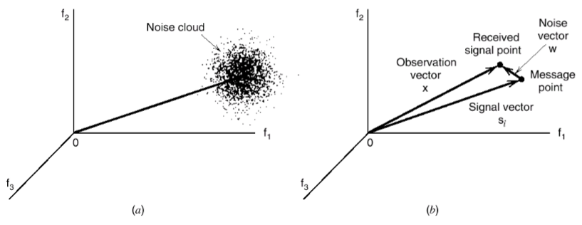
OPTIMUM RECEIVER USING COHERENT DETECTION
The received vector:

Slide 19
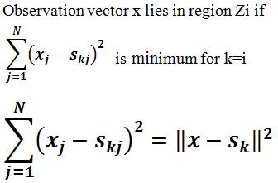

Slide 20
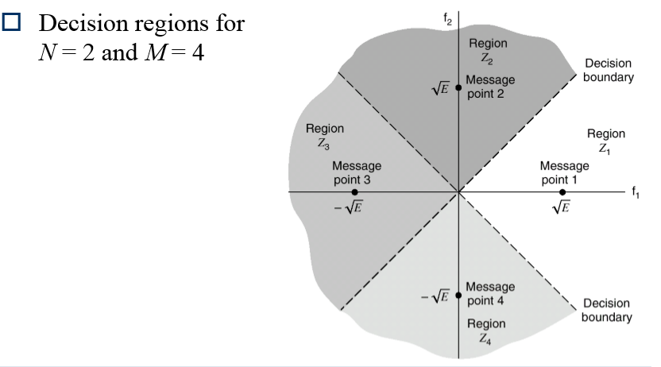

Slide 21
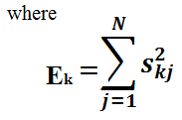
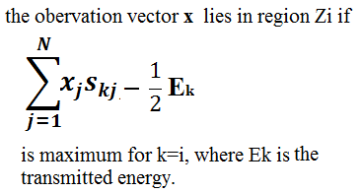

Slide 22
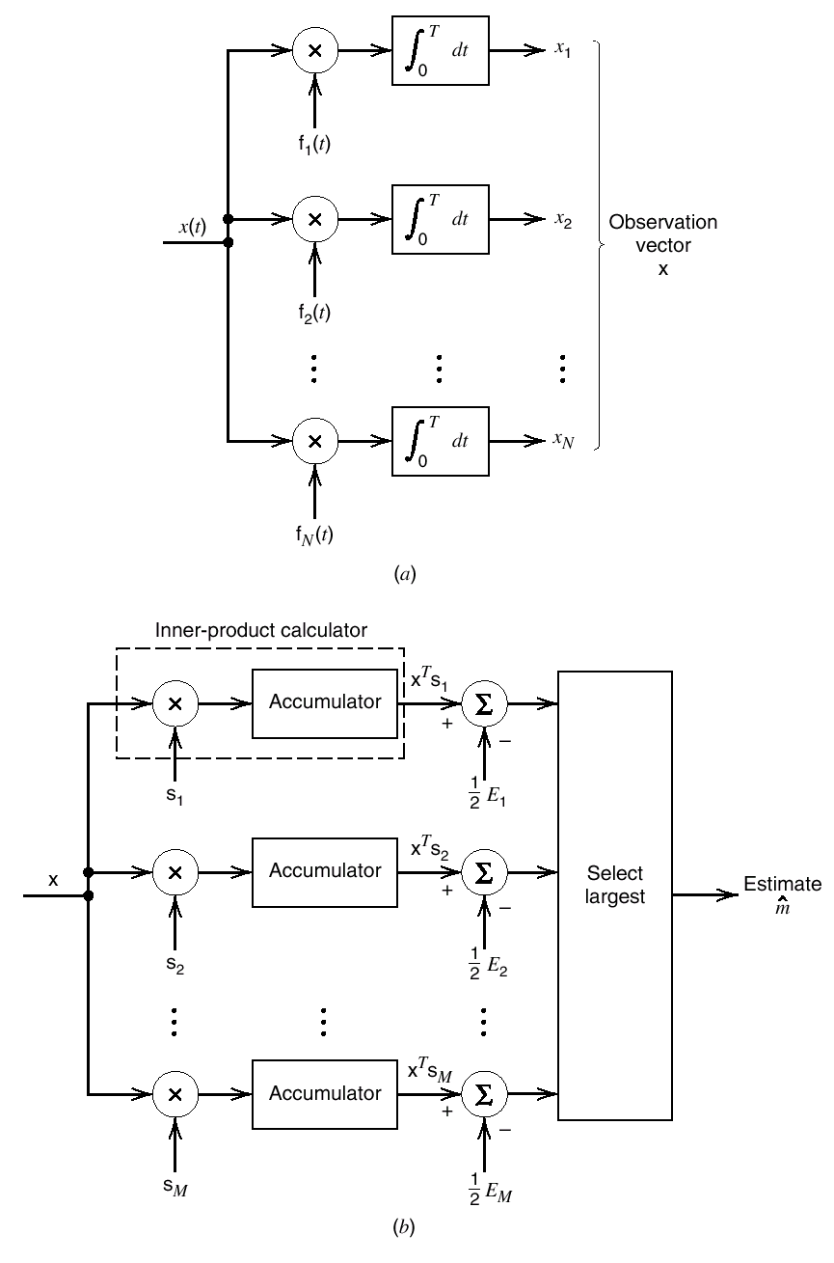
CORRELATION RECEIVER
Detector or demodulator.
(b) Signal transmission decoder.

Slide 23
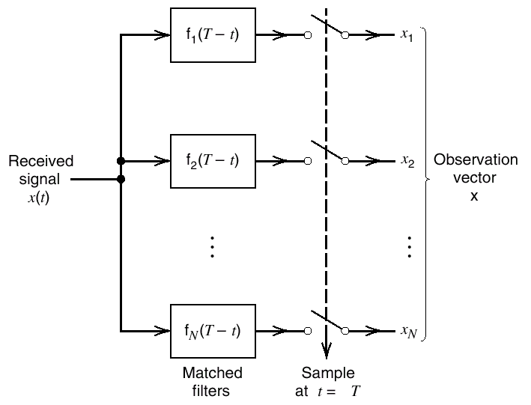
MATCHED FILTER RECEIVER

Slide 24
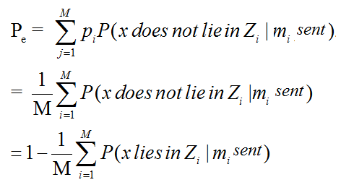
PROBABILITY OF ERROR

Slide 25
The probability of error is invariant to rotation and translation of the signal constellation.
In maximum likelihood detection the probability of symbol error Pe depends solely on the Euclidean distances between the message points in the constellation
The additive Gaussian noise is spherically symmetric in all directions in the signal space.

